Slide 1
Executive Summary
Date:2/7/20
Project Name: Windows Packer/Loader
Team Name: BluSh3ll
Deliverables:
CLIN-1 Customer Reporting “Quad -Pack” – 2/7/20, 3/6/20
CLIN-2 Weekly Activity/Time Sheet – Due every Friday
CLIN-3 Poster Paper – 4/30/20
CLIN-4 Encryption and Compression Design and Techniques Report – TBD
CLIN-5 Final Report and Team Presentation – 4/3/20
CLIN-6 Product Specifications – TBD
CLIN-7 Packer/Loader Source Code and Completed/Compiled Tool – 4/24/20
Key Accomplishments:
Packer development has continued. Approaching feature complete.
Issues: We are not as far into development as stated by our critical milestones, but we are confident in delivering the product by the specified date.
Schedule Status: On schedule to complete coding phase in two weeks.
Cost Status: No monetary cost, 356 hours contributed

Slide 2
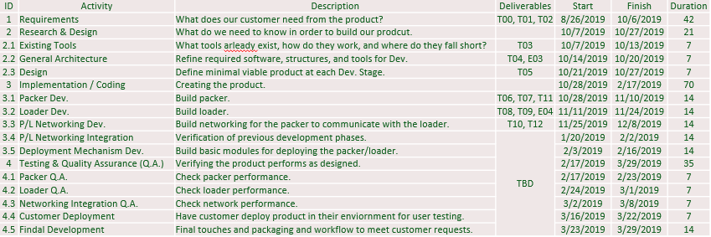
Issues/Future Plans
Critical Milestone Dates:
Return to “Green” Plan (if Issues)”
Cut back testing & development phase to allocate additional time to fix issues.
Plans for Next Reporting Period:
Complete 3.1-3.4

Slide 3
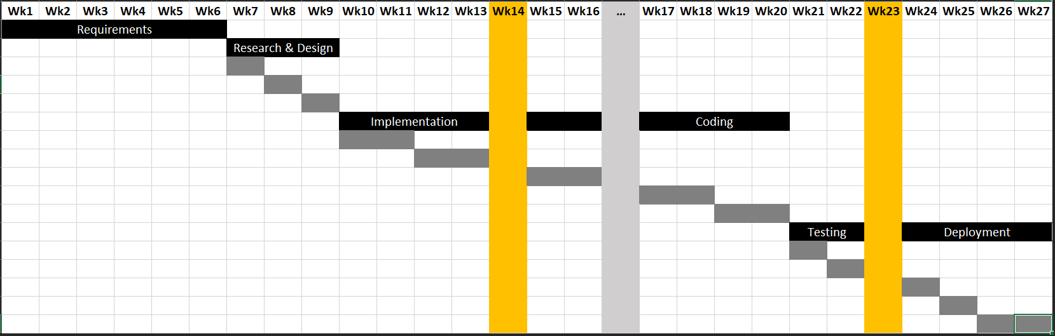
Schedule
Comments:
Behind schedule on 3.1 - 3.4 (see critical milestones on previous slide)

Slide 4
Customer Satisfaction Survey Date:
Customer Satisfaction
SPONSOR: to provide Ratings and Comments
IMPORTANT: be sure to request well in advance of due date

